Slide 1

Covid-19 Analysis and Introducing Prediction Algorithms in machine learning
Presenter: Arshia Ilaty
CS 631 – Spring 2023

Slide 2
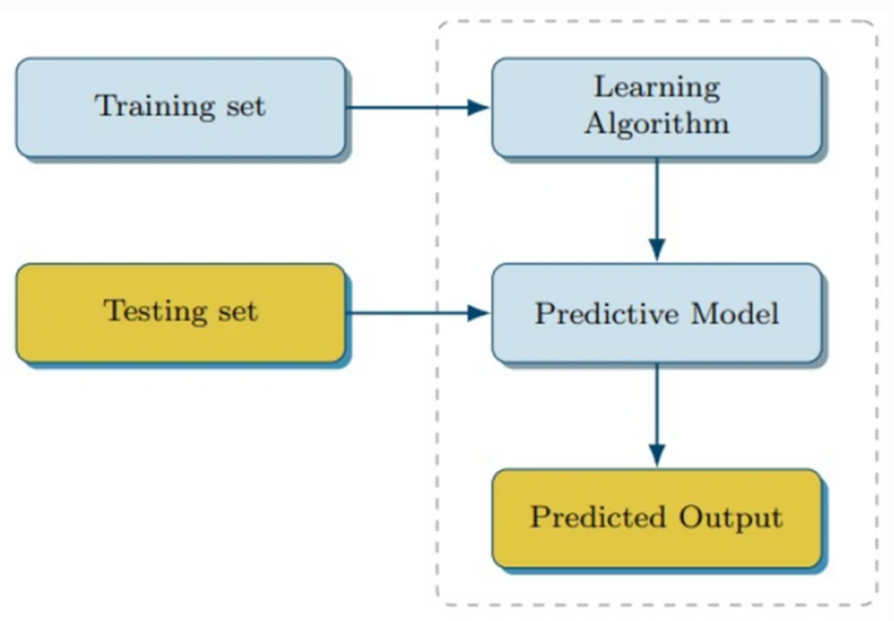
introduction:
Preprocess phase
Understanding the data and its types
Handling missing values(null) and duplicated rows
Data cleaning
Scaling and normalization
Feature selection and engineering
Algorithm selection and training phase
LSTM
ARIMA
SARIMA
PROPHET
Random Forest
SVM
Polynomial Regression
Bayesian Ridge Polynomial Regression

Slide 3
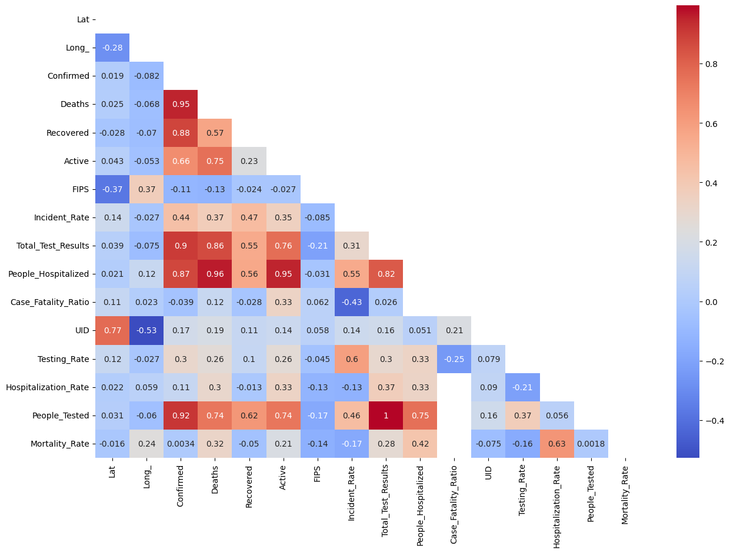
correlation matrix for feature selection and engineering

Slide 4
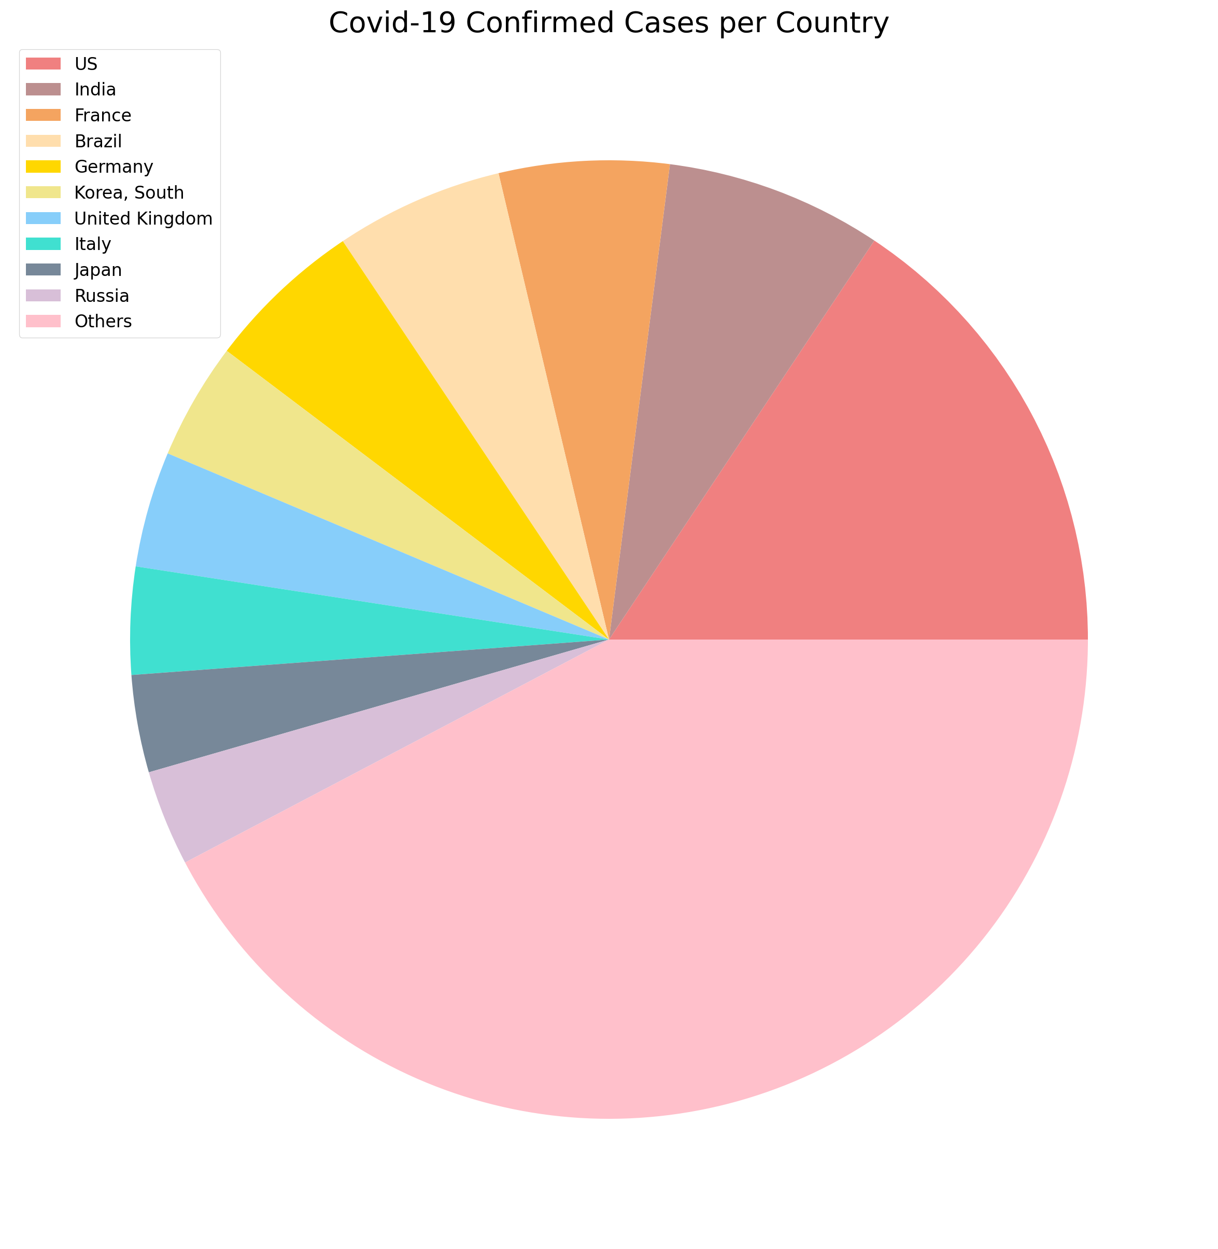
Confirmed Cases per country

Slide 5
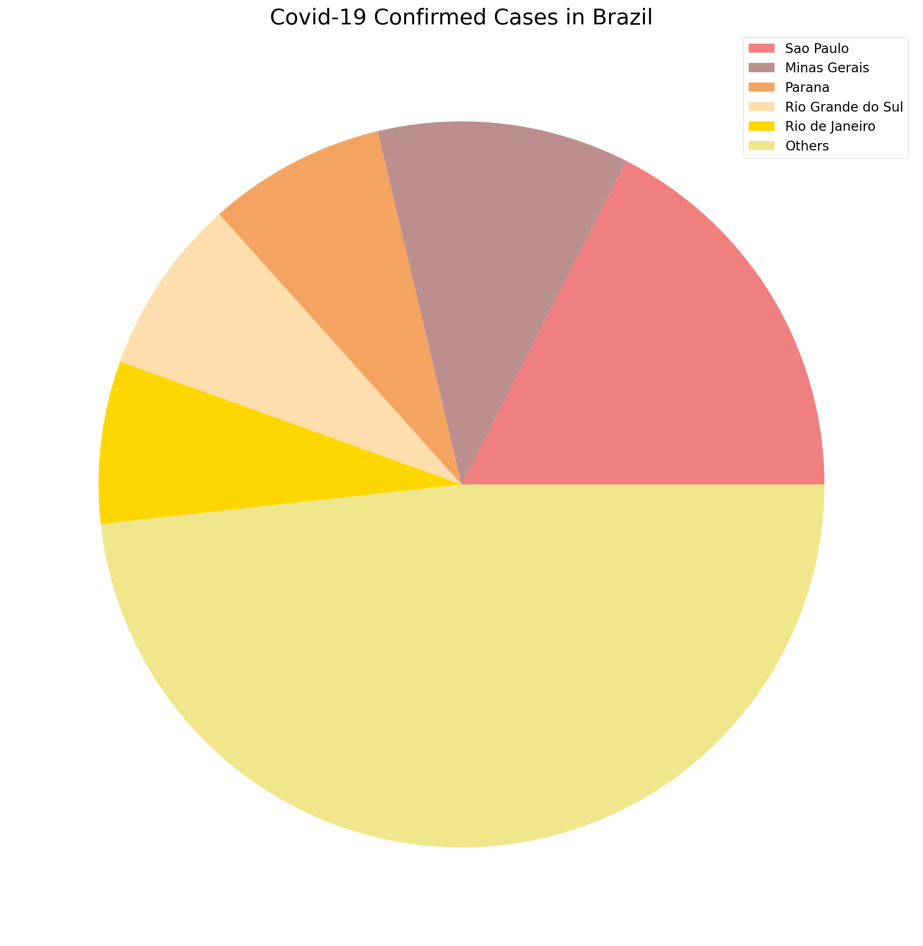
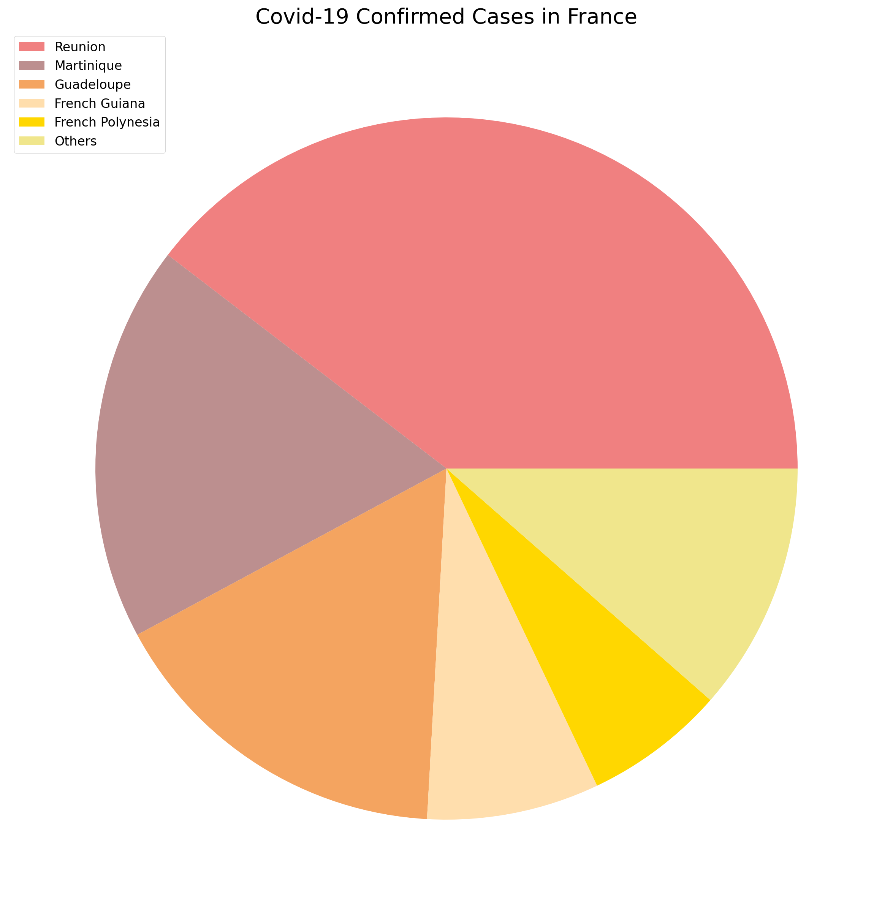
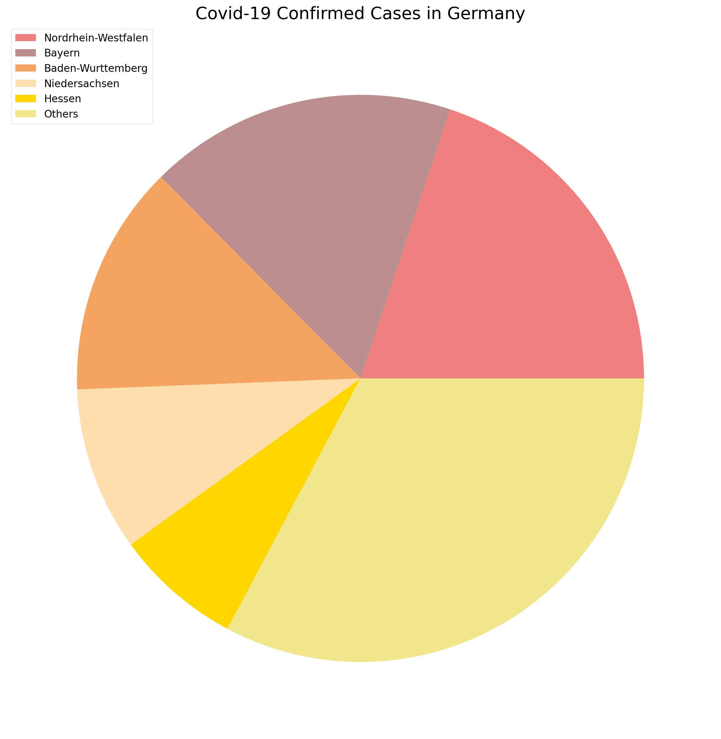
Confirmed Cases for different countries

Slide 6
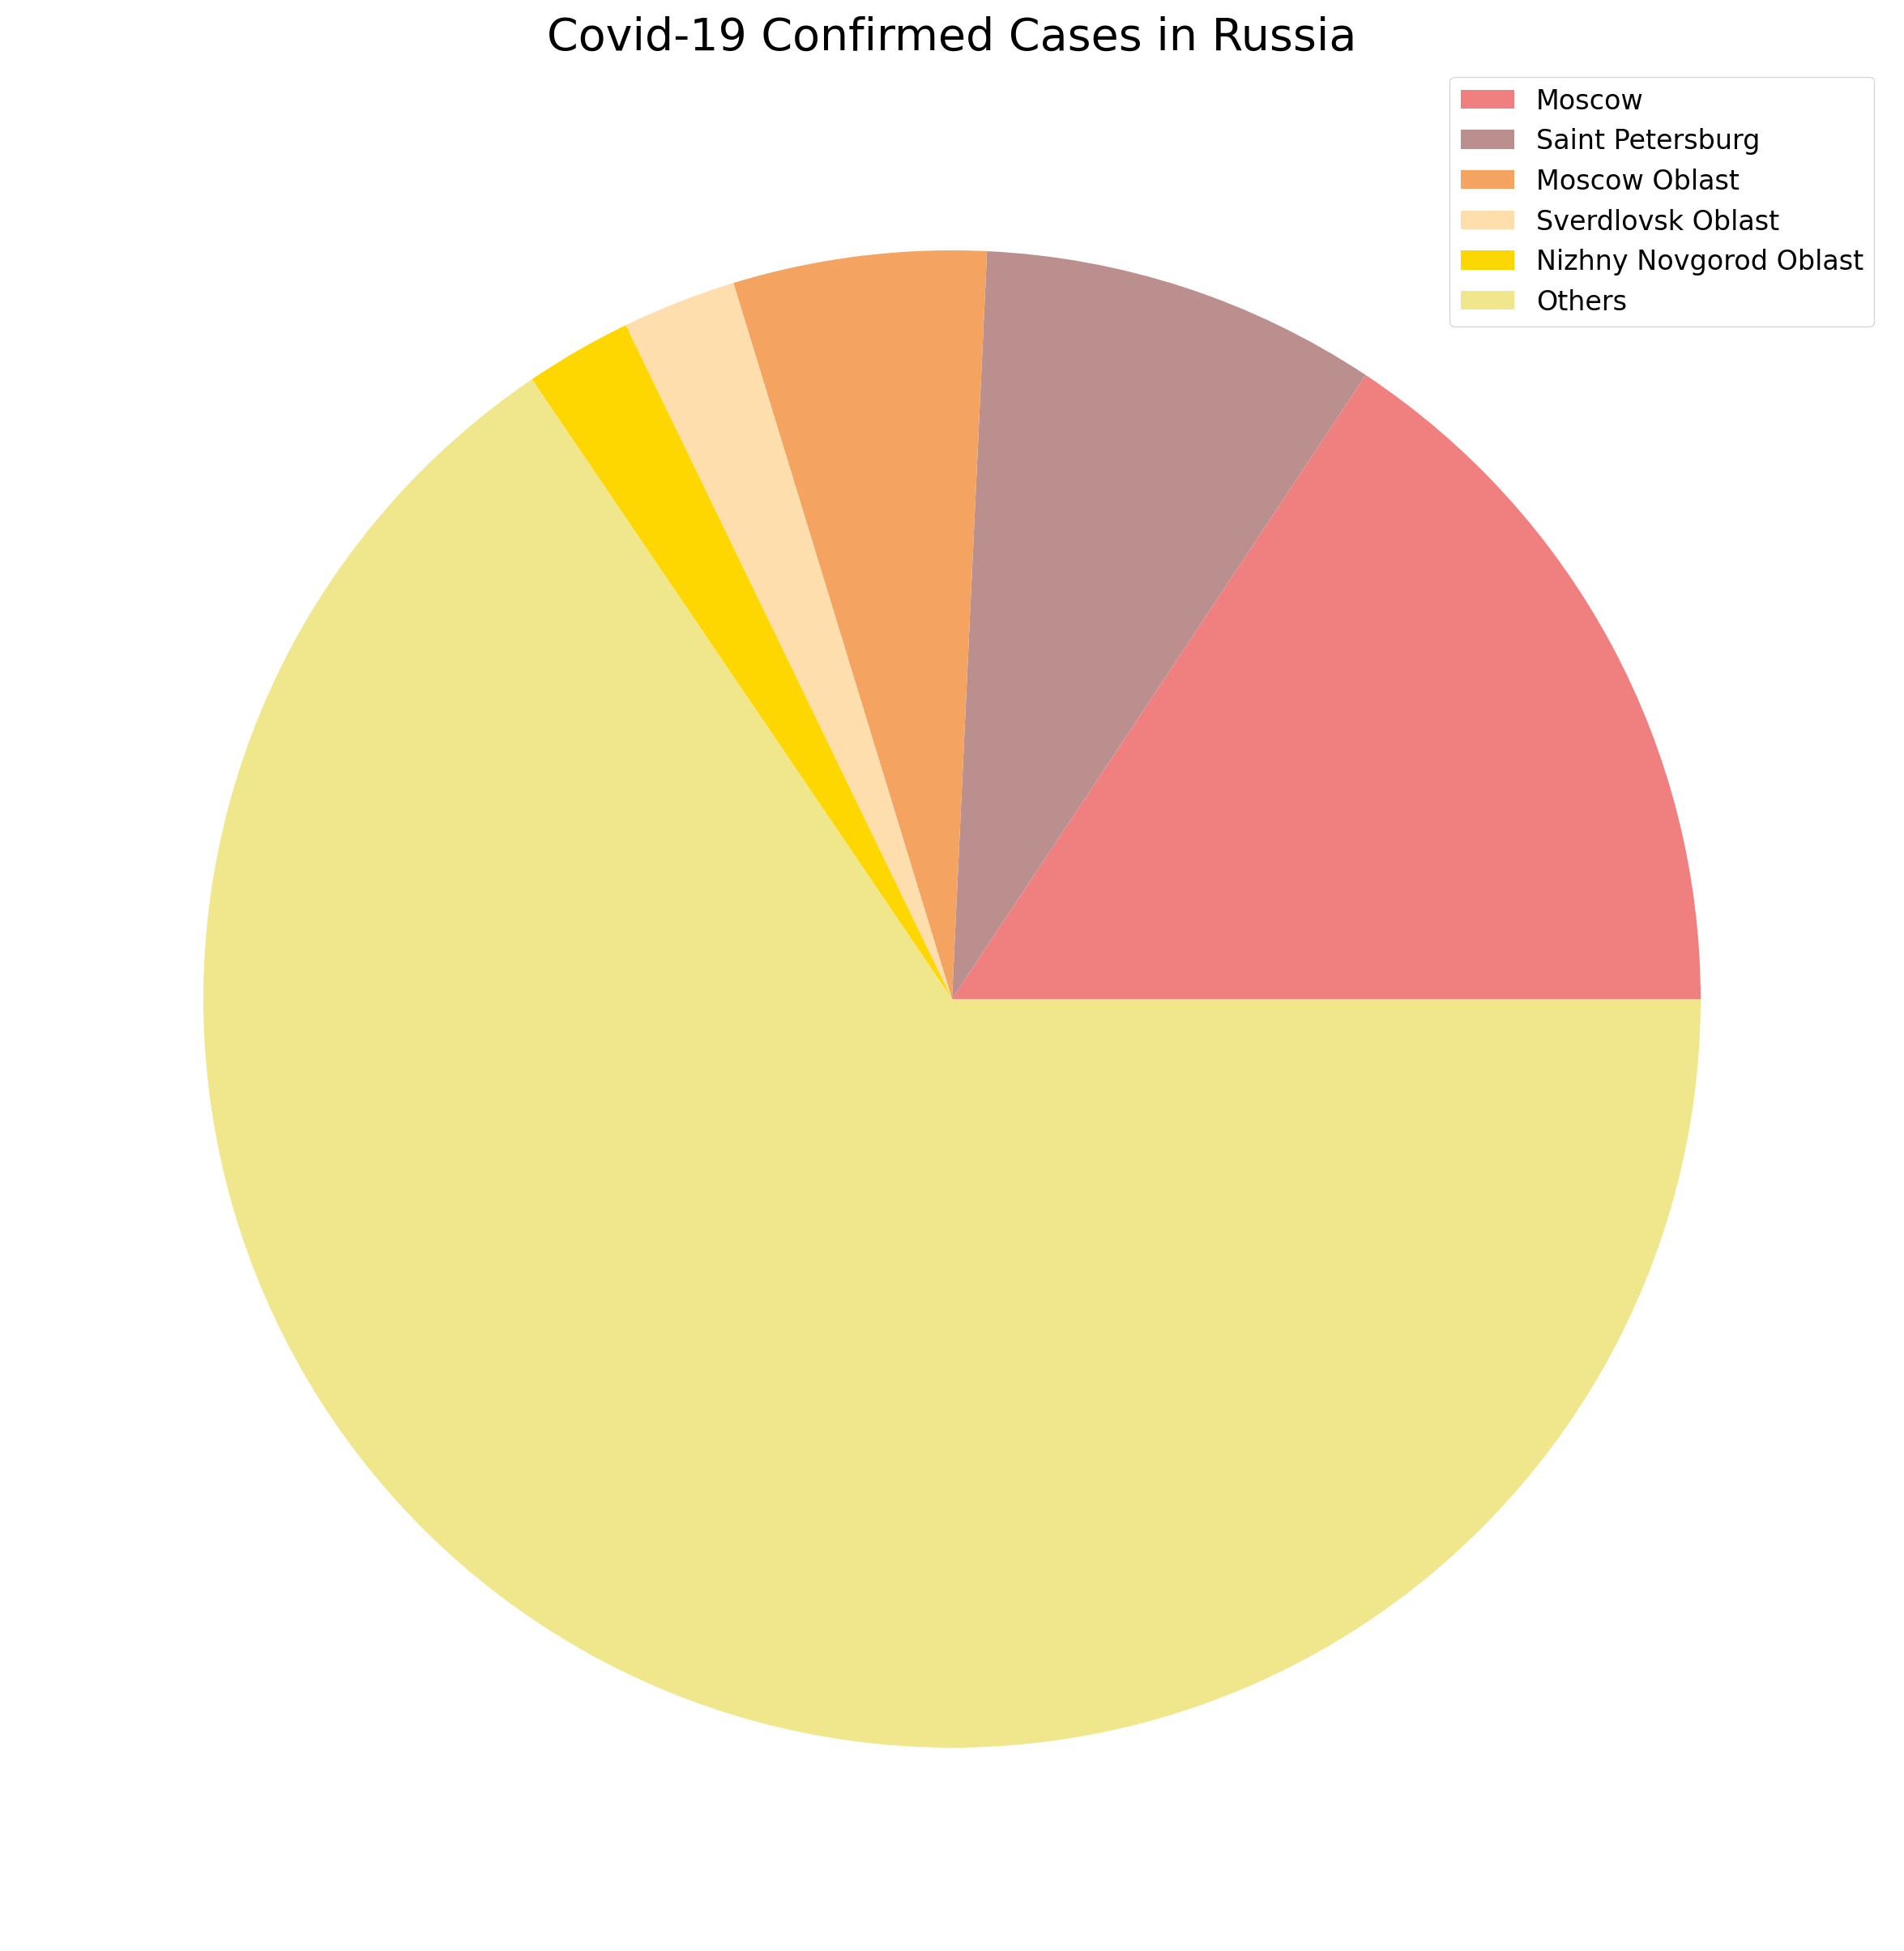
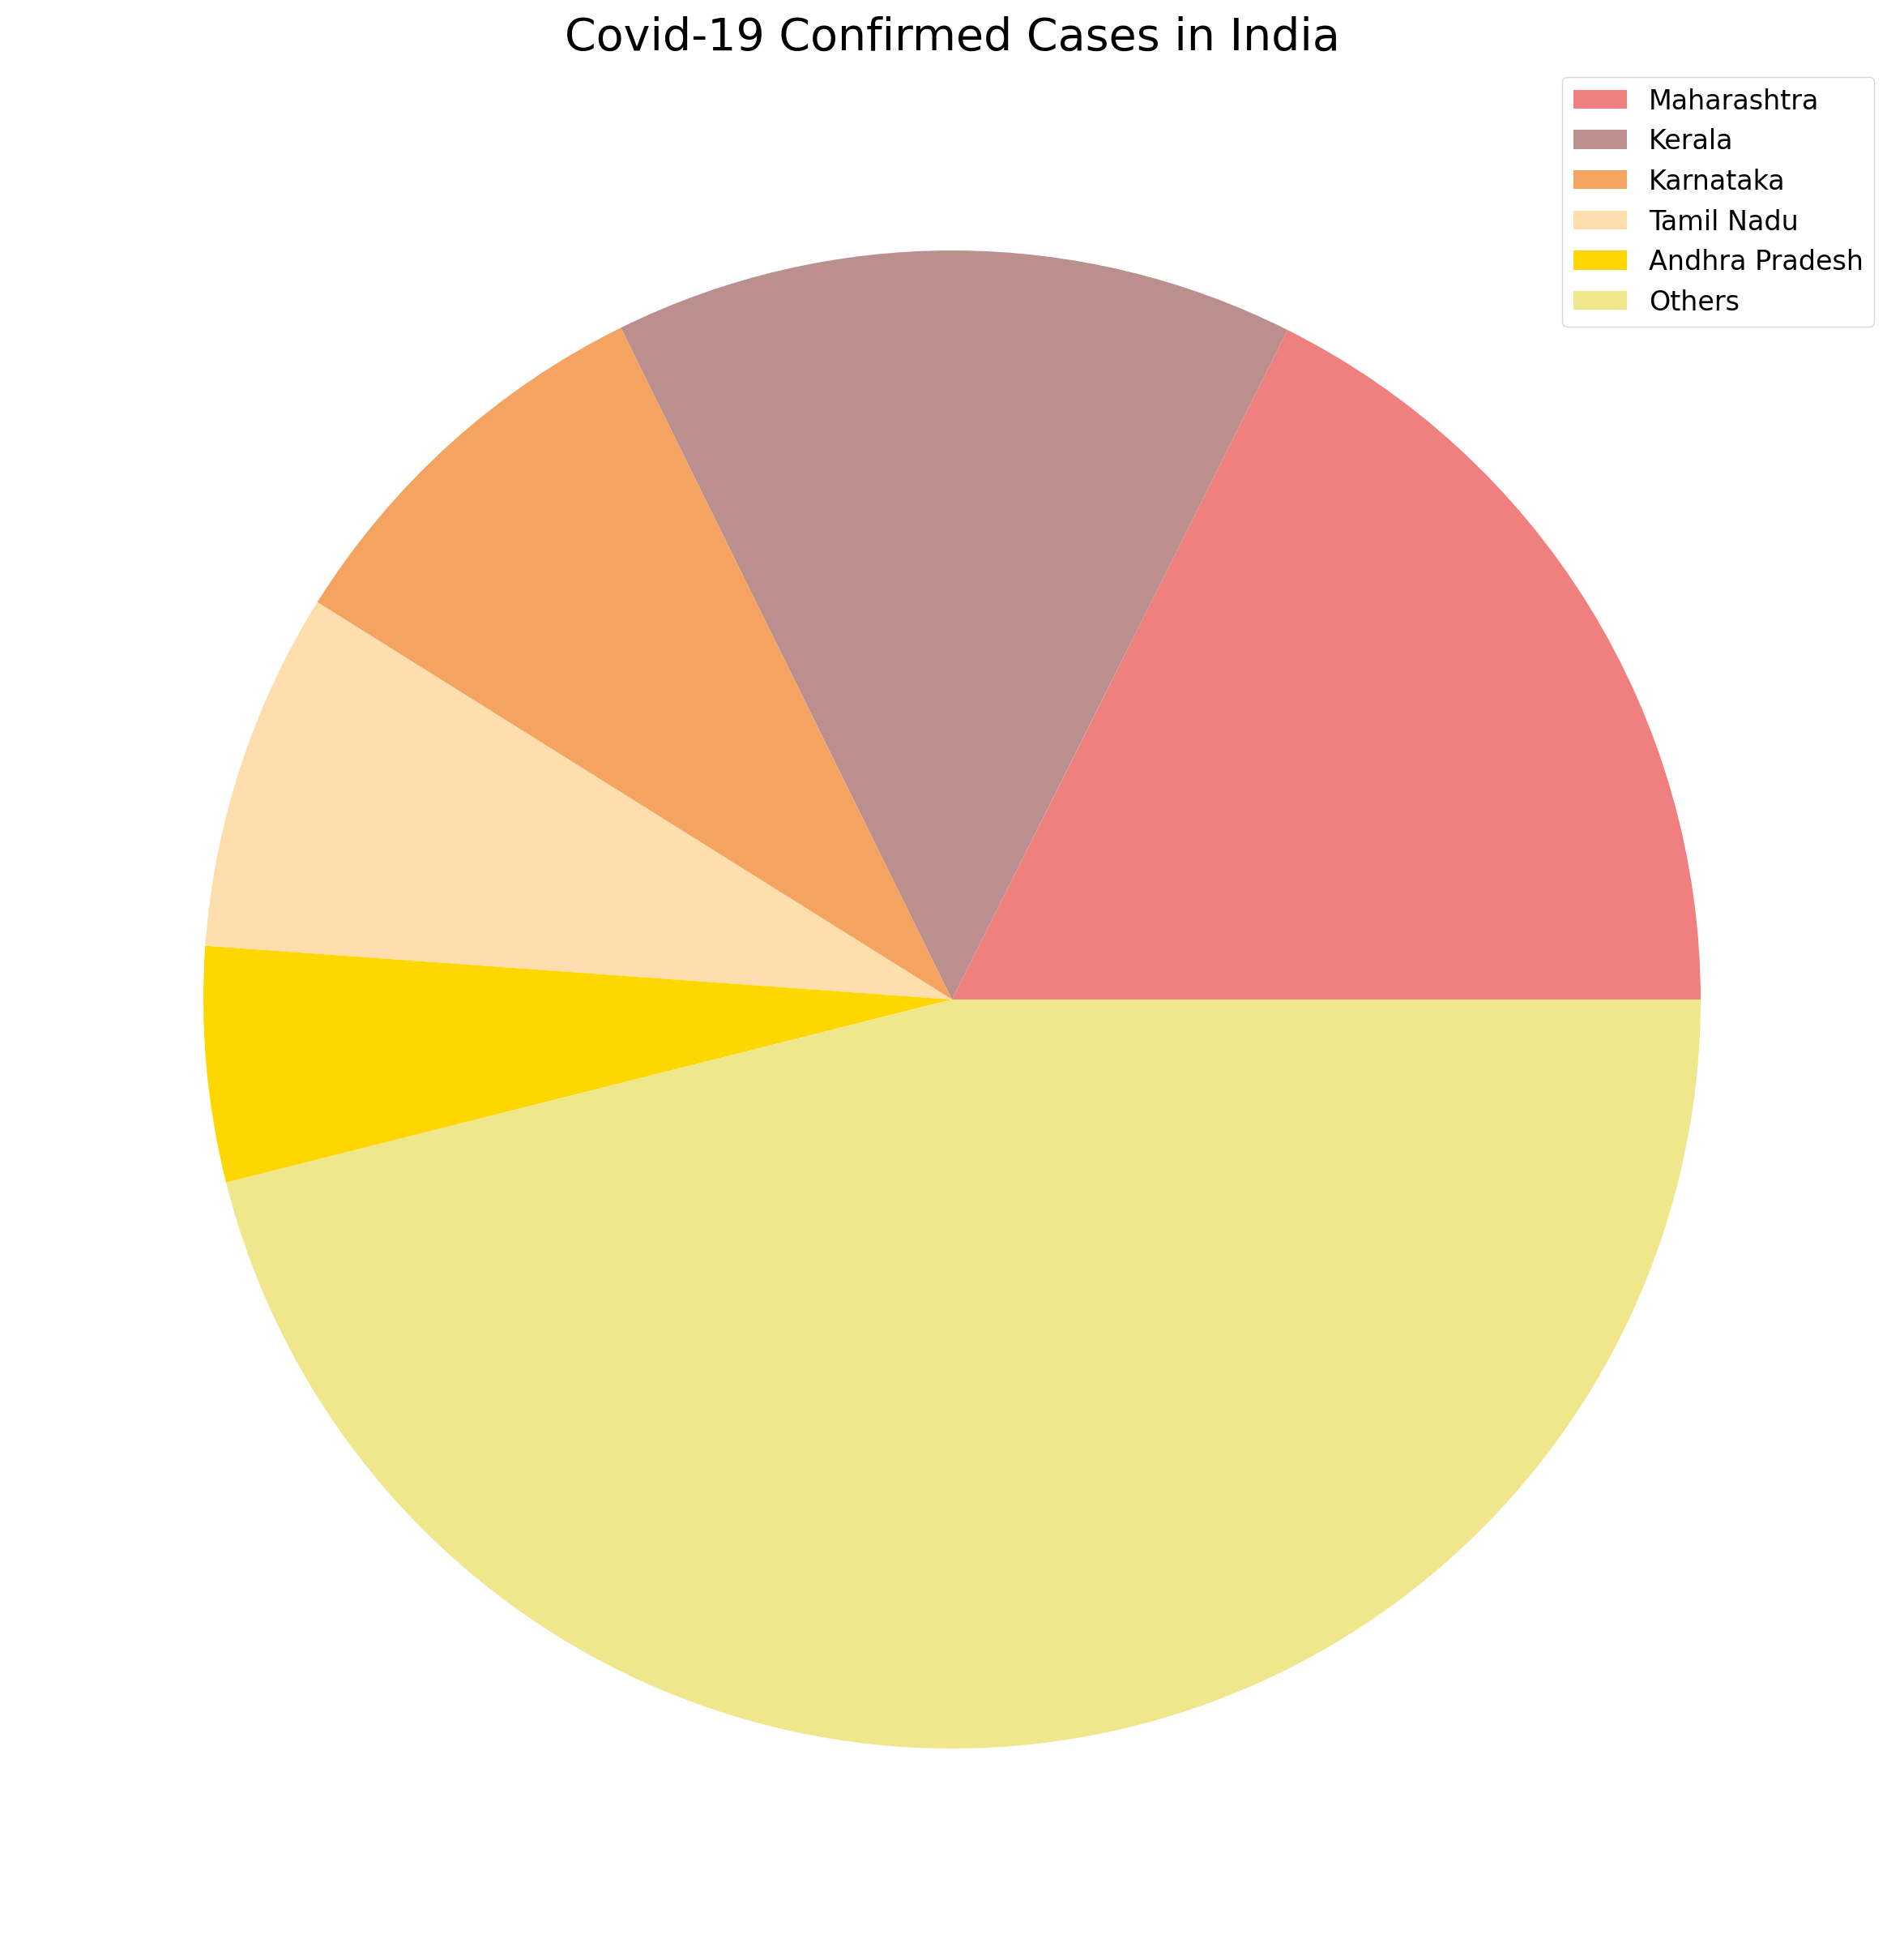
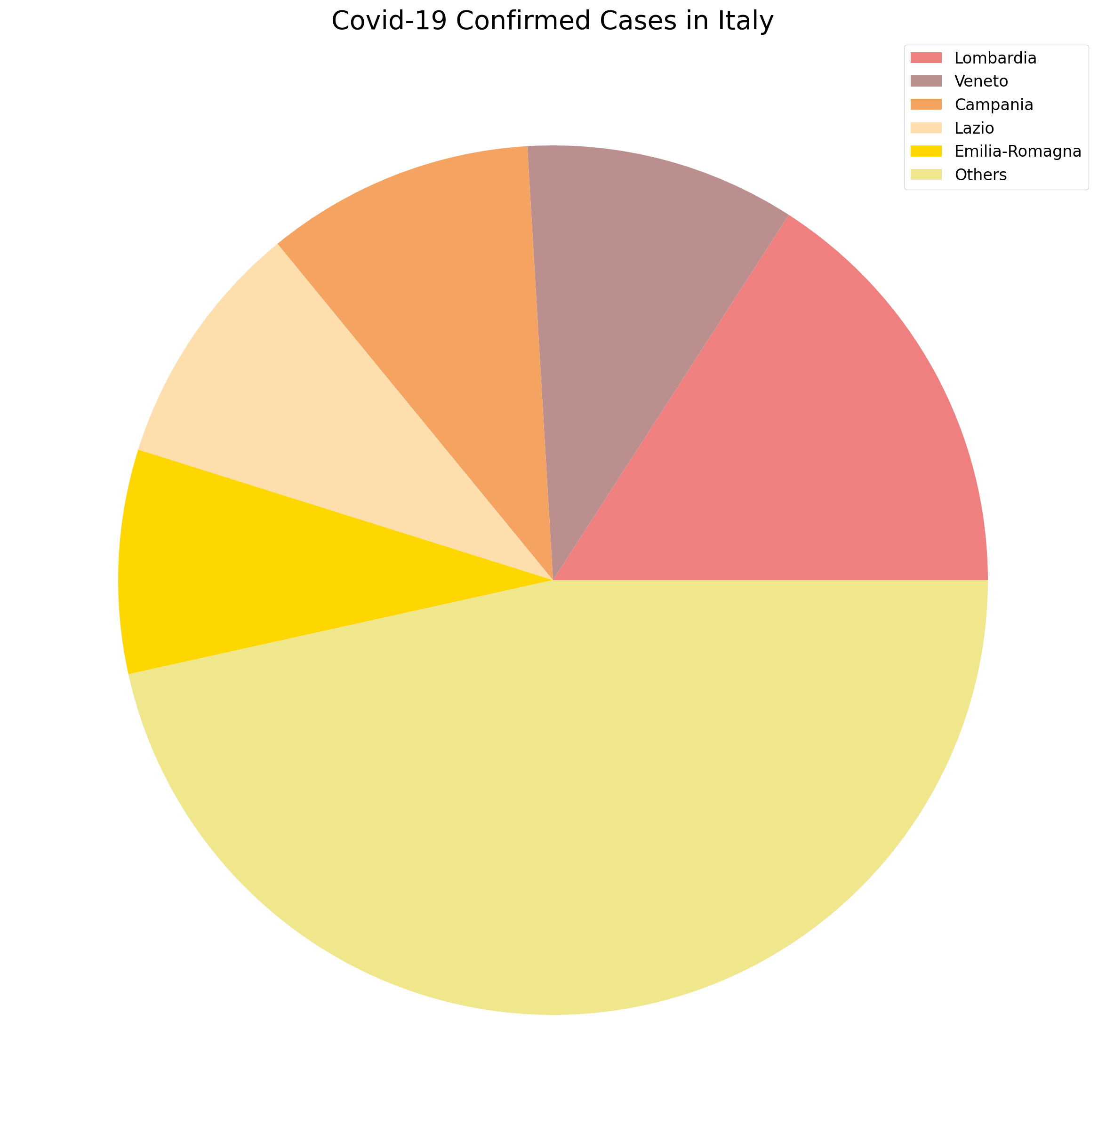
Confirmed Cases for different countries

Slide 7
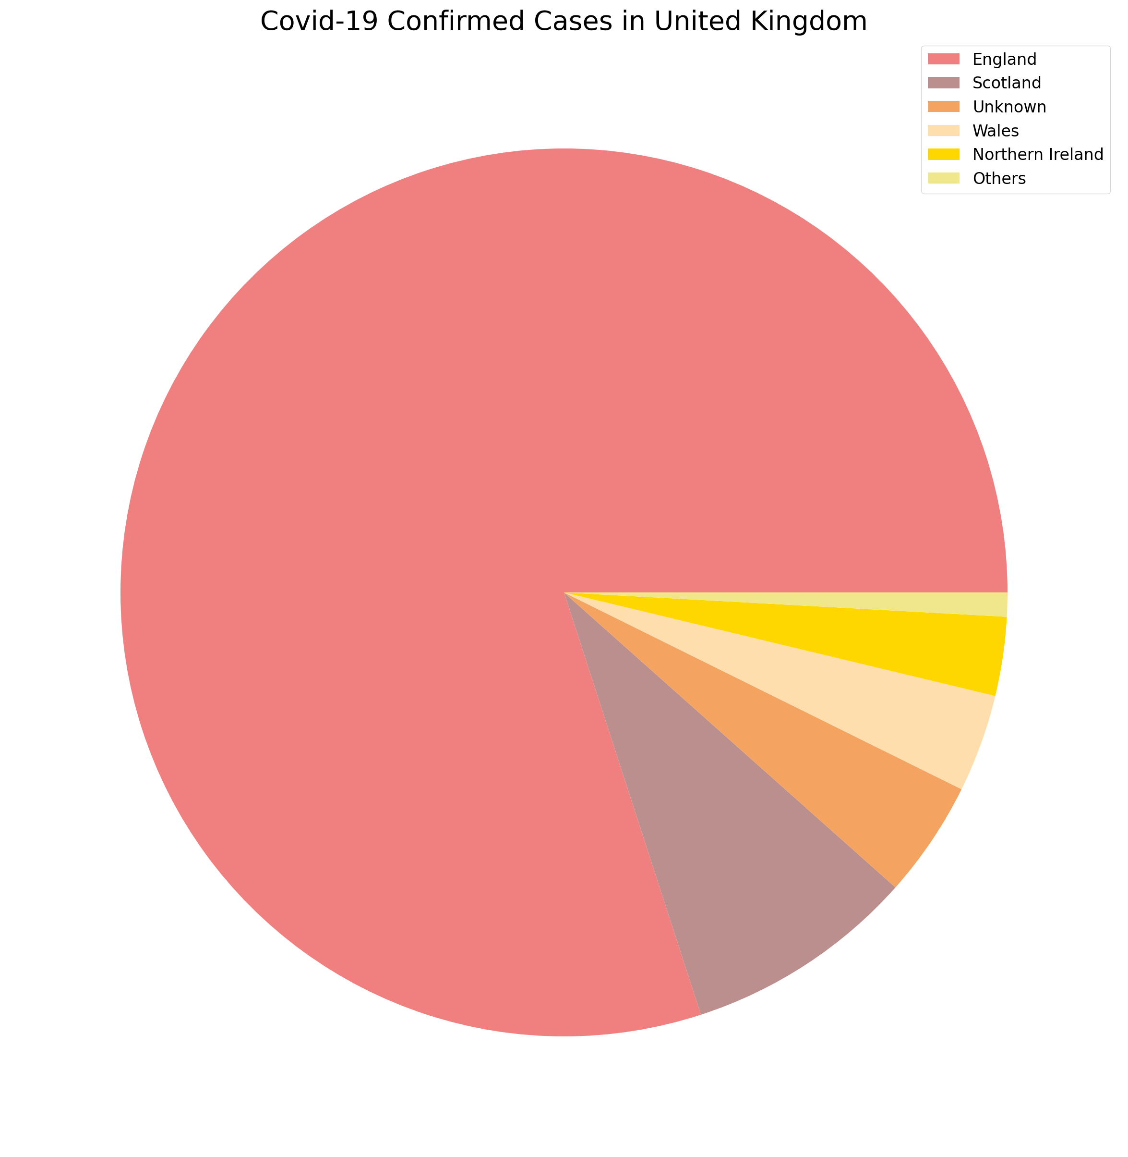
United kingdom analysis

Slide 8
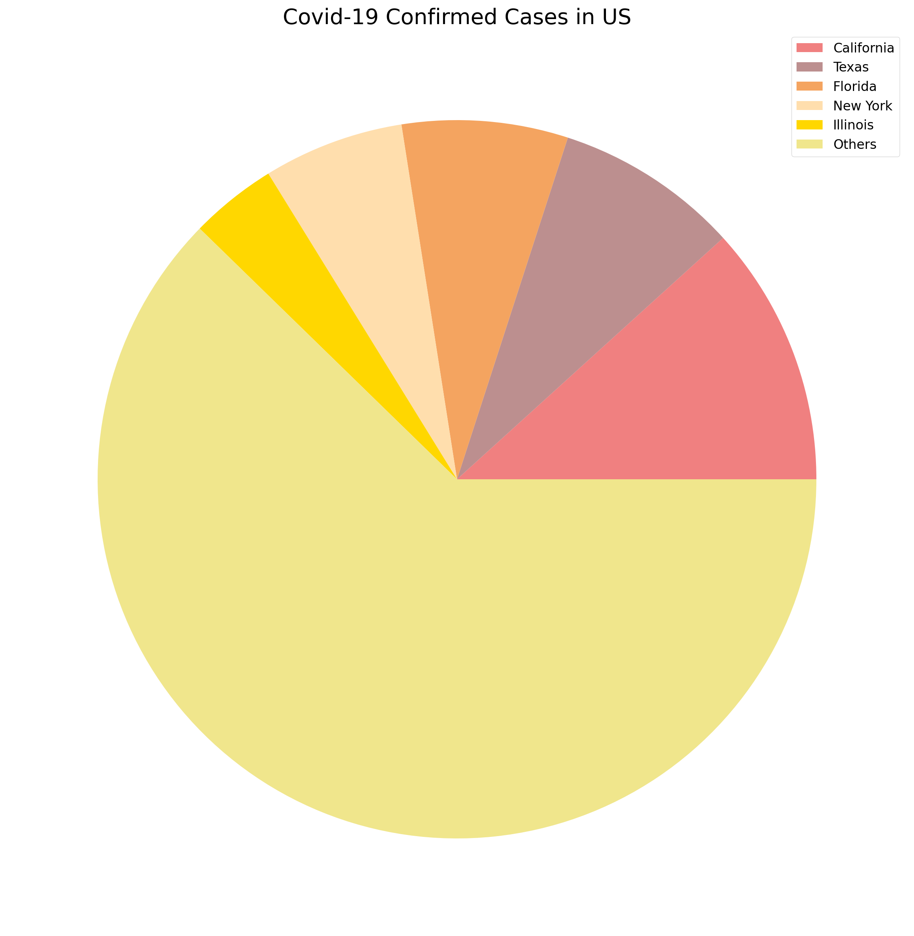
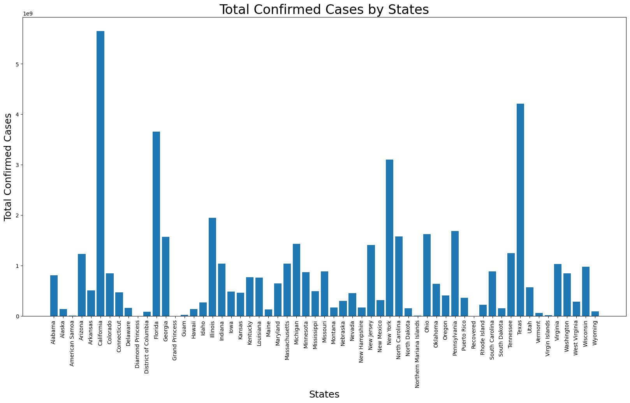
United states analysis

Slide 9
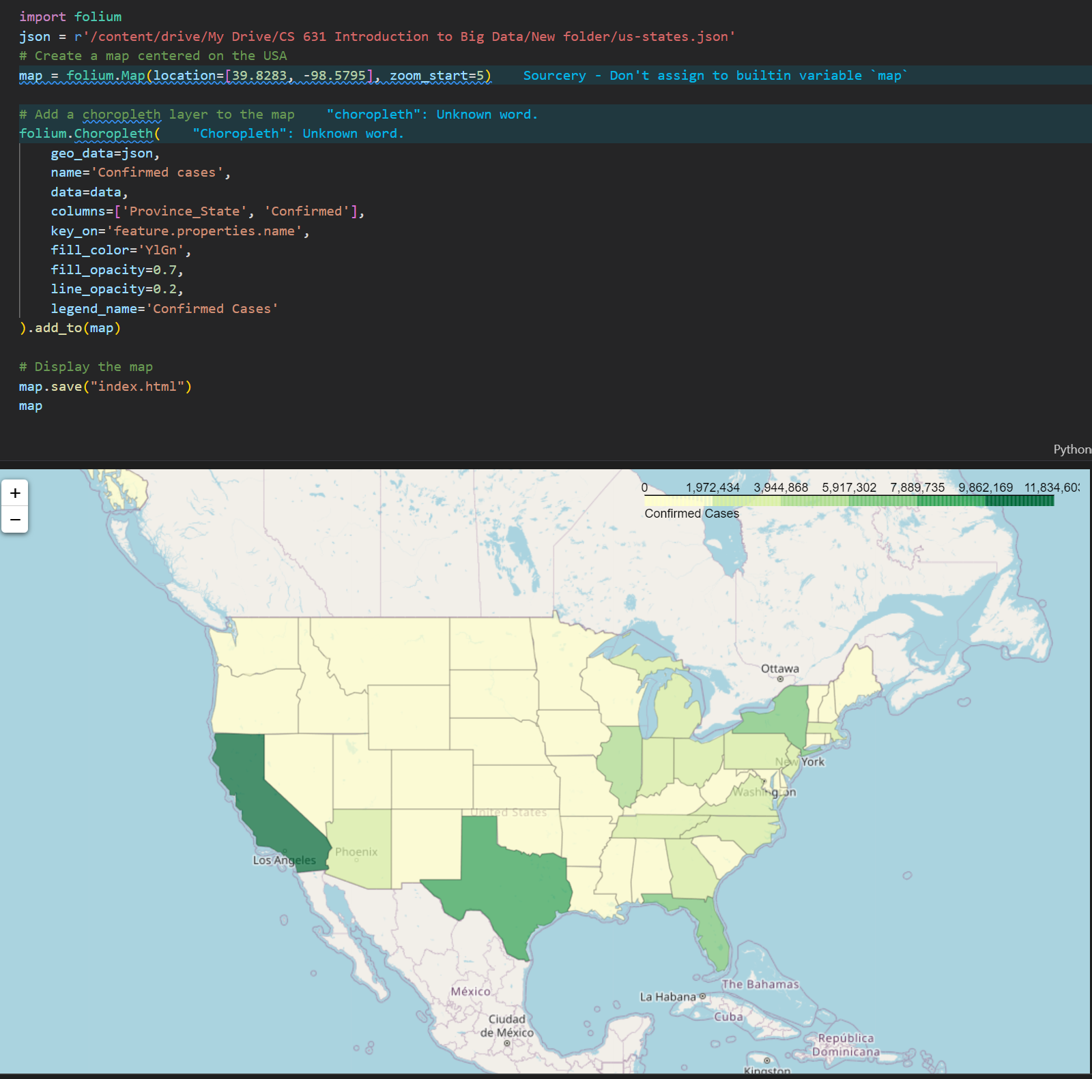
The US covid map with the help of Python Folium

Slide 10
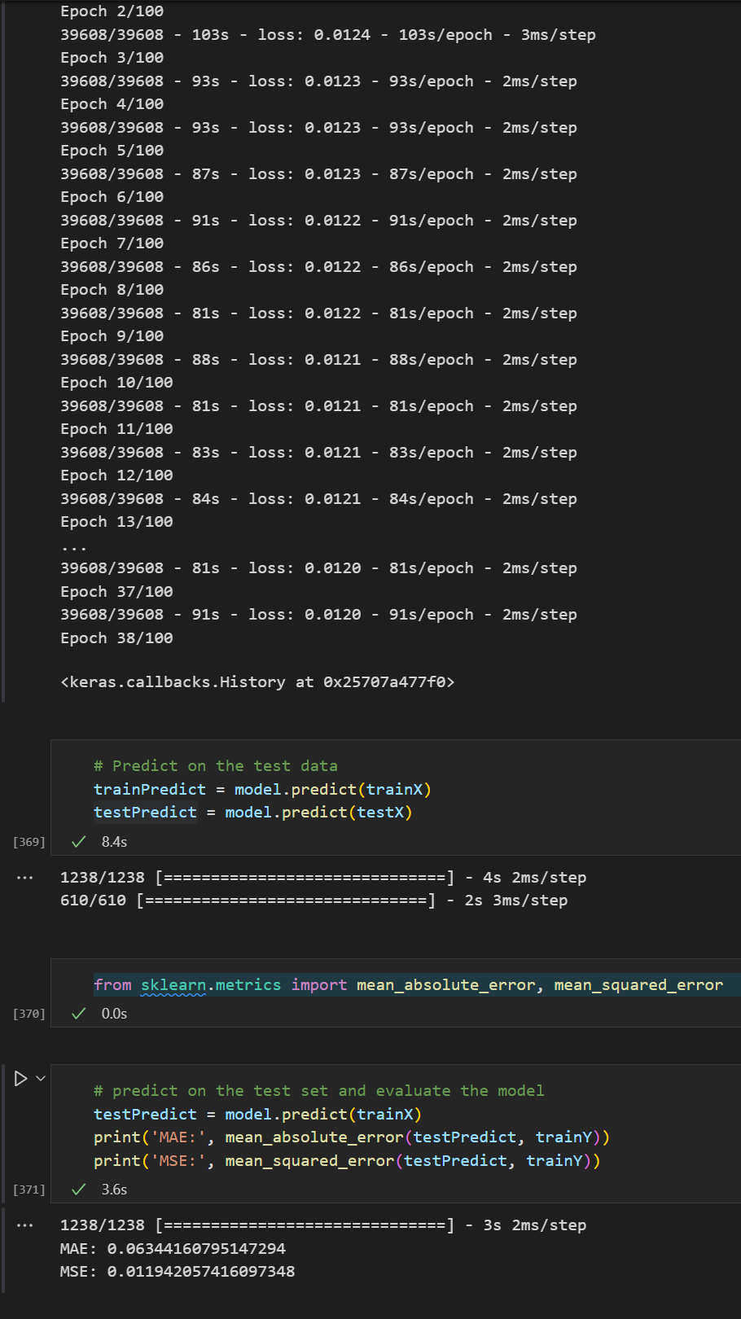
Train LSTM on us dataset
MAE (Mean Absolute Error): 0.0634
Measures the average magnitude of the errors in a set of predictions, without considering their direction
The LSTM model's predictions are off by about 6.34% from the actual values
MSE (Mean Squared Error): 0.0119
Measures the average squared difference between the predicted and actual values
The LSTM model's predictions are off by about 1.19% from the actual values
Difference: MSE gives more weight to larger errors than MAE

Slide 11
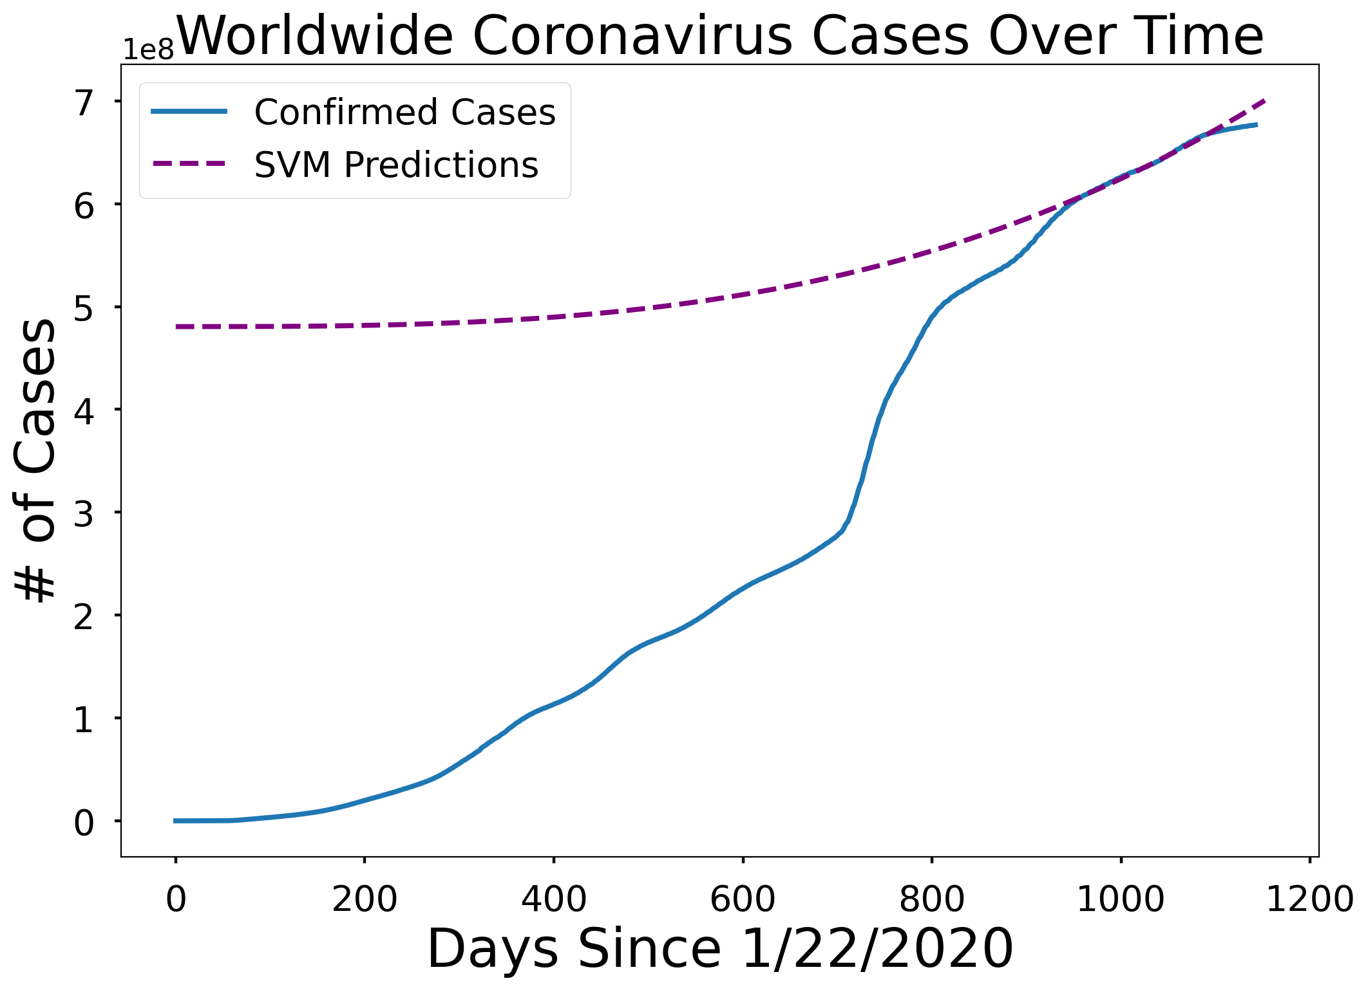
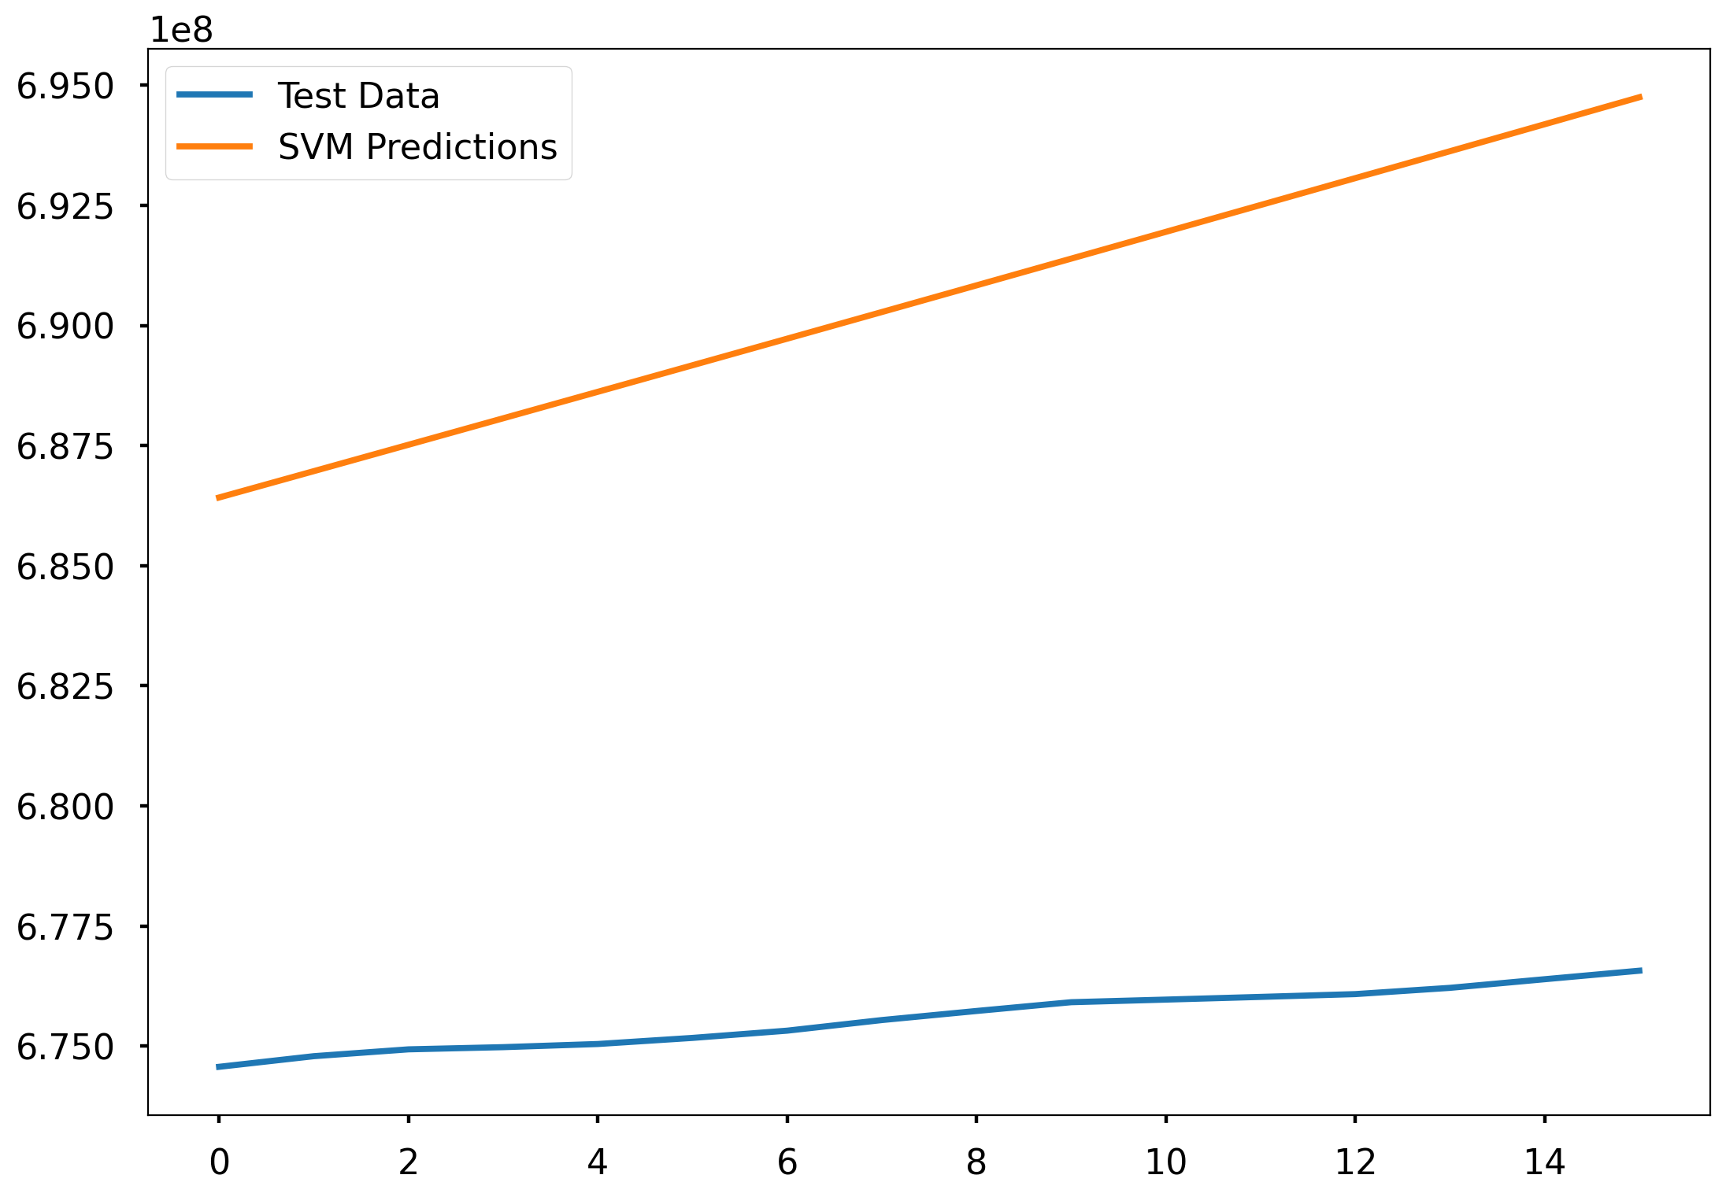
prediction
Mean Absolute Error(MAE): 14989630.117149115

Slide 12
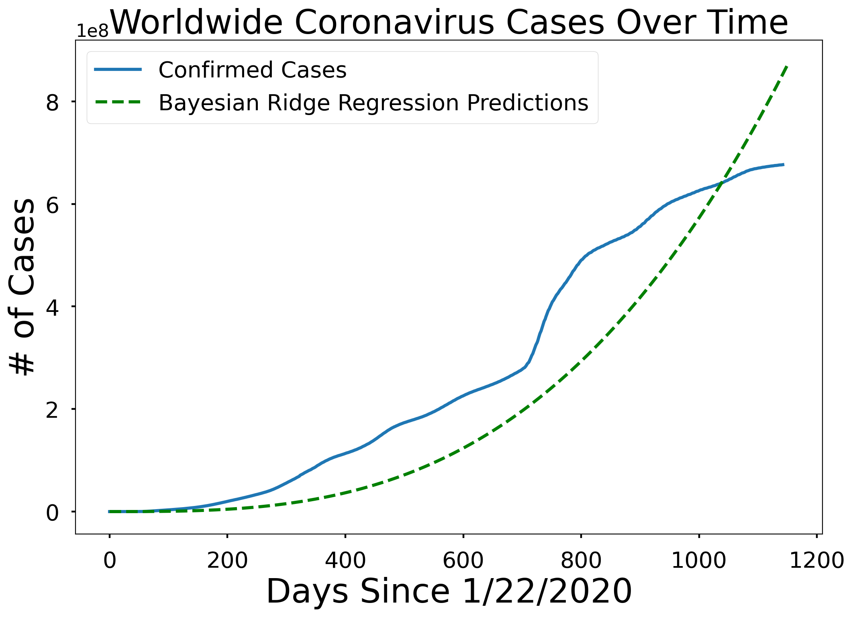
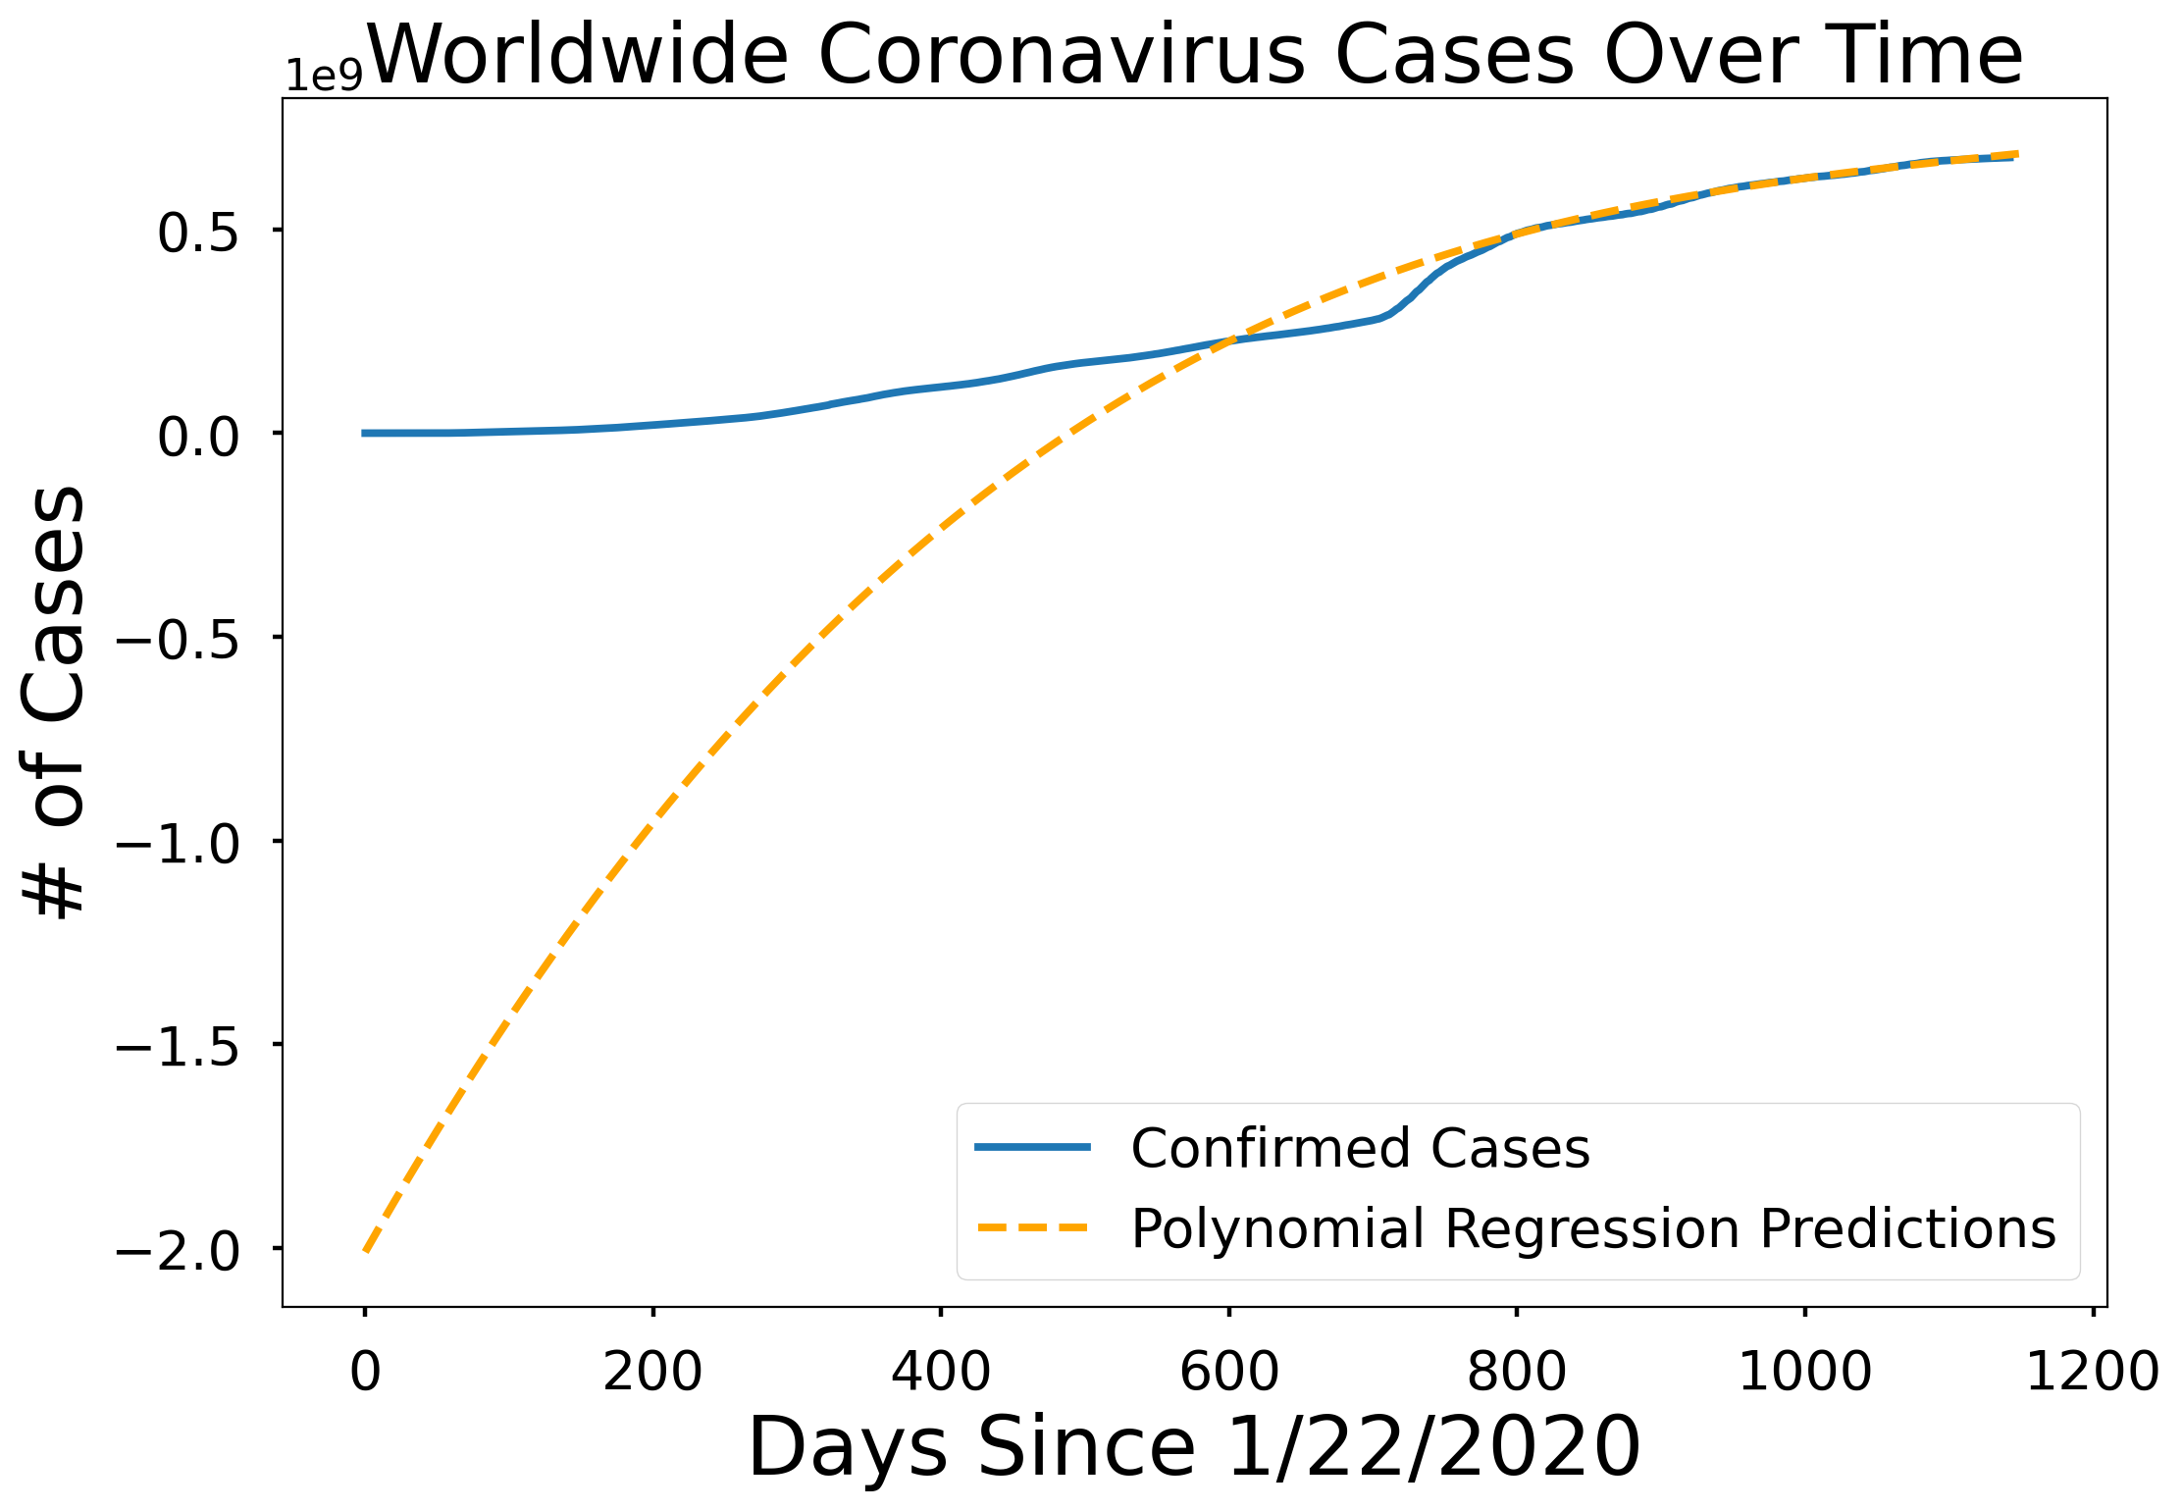
prediction

Slide 13
References and credits
Kaggle crash course (https://www.kaggle.com/learn) + Notebooks
Hands-on Machine learning with Scikit-learn, Keras, and TensorFlow Written by Geron Aurelien (O'Reilly)
GitHub repositories
Medium posts
Papers are mentioned in my report

Slide 14
Questions, concerns, comments?
Thank you!

